Slide 1
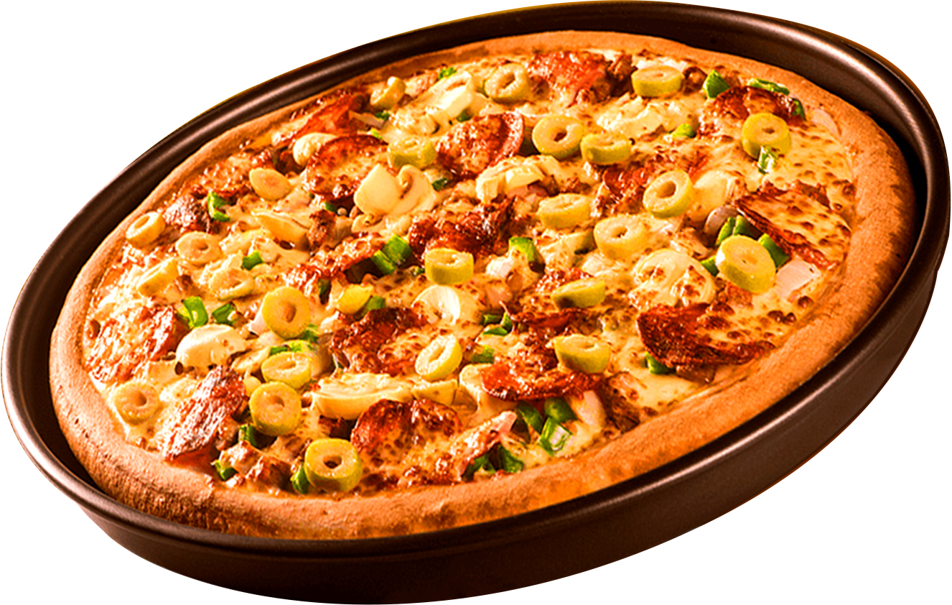
PIZZA SALES
ANALYTICS
Data-driven insights
Amith S K

Slide 2



BUSINESS INSIGHTS
ANALYSED
Retrieved the total number of orders placed
calculated the total revenue generated from pizza sales
Identified the highest-priced pizza
Identified the most common pizza size ordered
Listed the top 5 most ordered pizza types along with their quantities
Join the necessary tables to find the total quantity of each pizza category ordered

Slide 3
BUSINESS INSIGHTS
ANALYSED CONTD...
Determined the distribution of orders by hour of the day calculated the total revenue generated from pizza sales
Joined relevant tables to find the category-wise distribution of pizzas
Grouped the orders by date and calculate the average number of pizzas ordered per day
Determined the top 3 most ordered pizza types based on revenue
Calculate the percentage contribution of each pizza type to total revenue
Analyzed the cumulative revenue generated over time
Determined the top 3 most ordered pizza types based on revenue for each pizza category

Slide 4
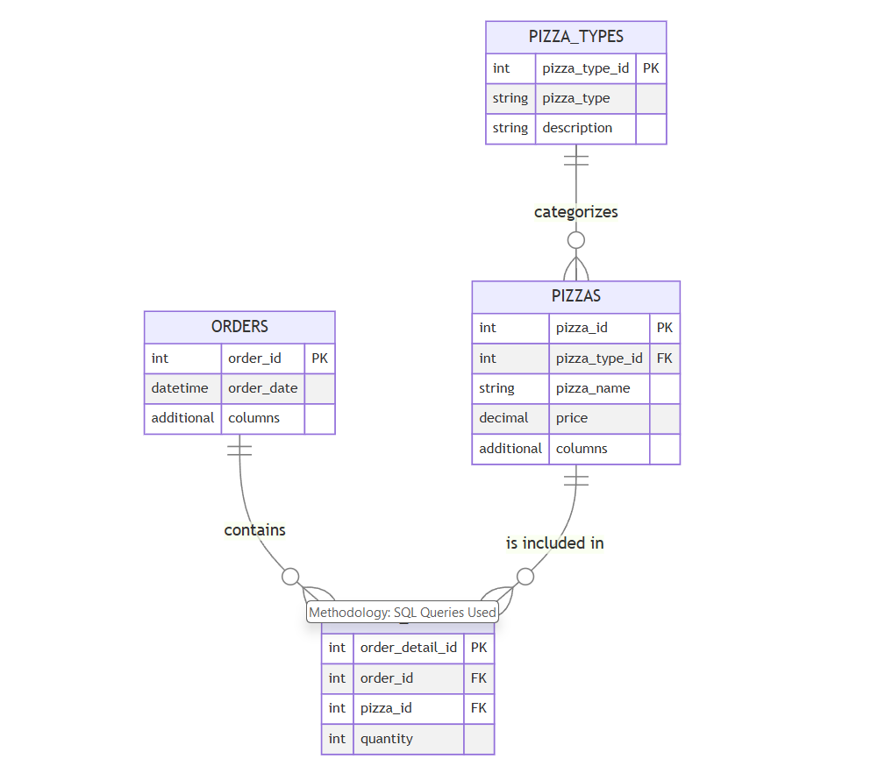
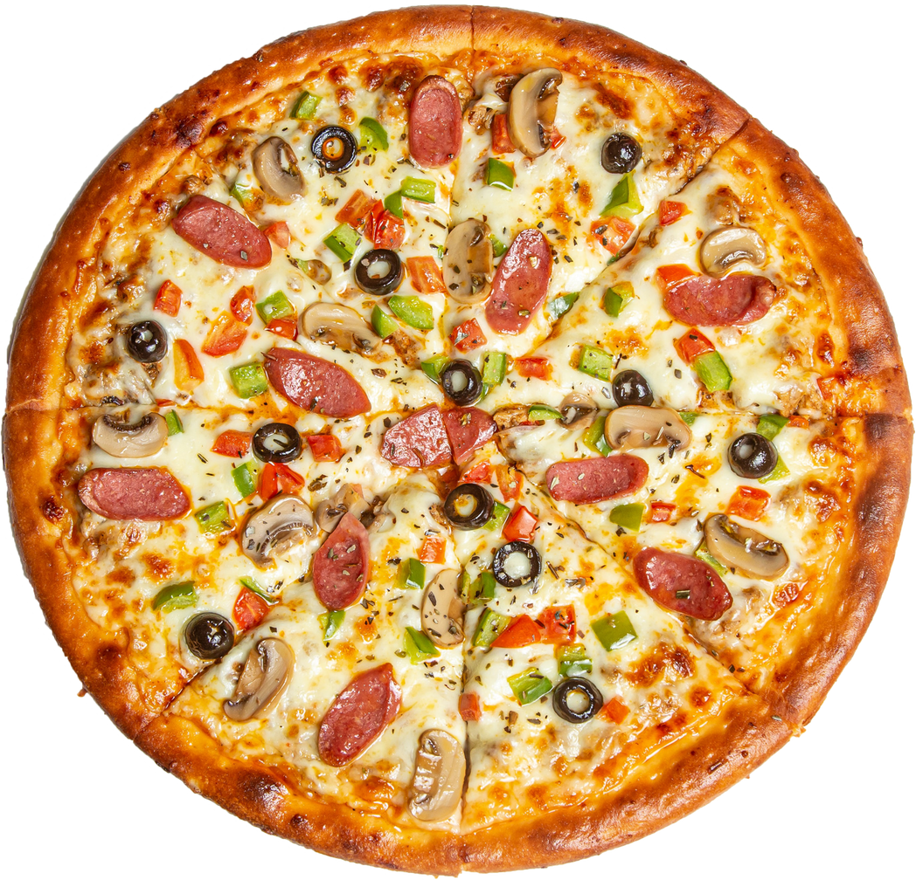
DATASET OVERVIEW

Slide 5
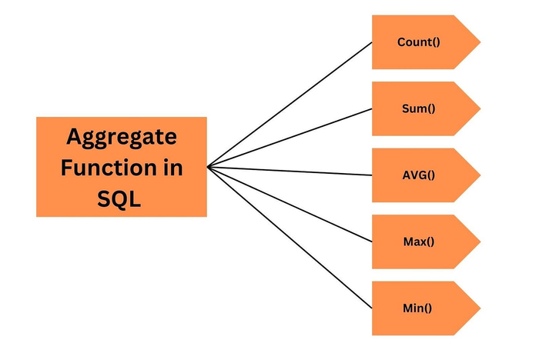
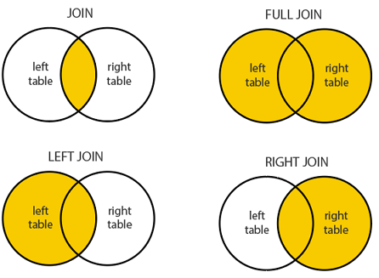
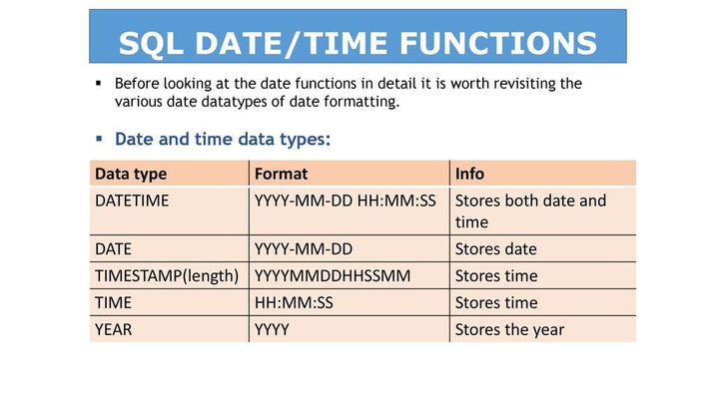
SQL FUNCTIONS
USED IN ANALYSIS
AGGREGATE FUNCTIONS
JOIN FUNCTIONS
DATE AND TIME FUNCTIONS
Used to analyze total sales,
most popular pizzas,
and revenue per pizza type.
Used to connect multiple tables
to get meaningful insights.
Used to determine the busiest
hours for pizza orders

Slide 6
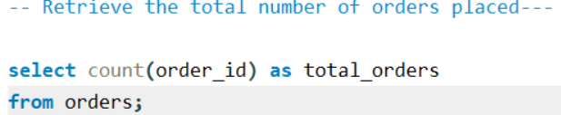
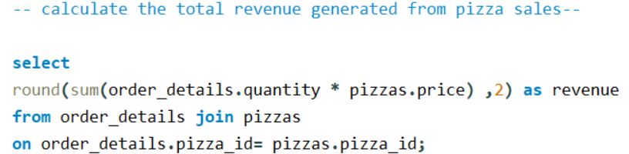
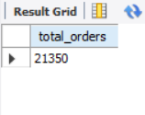
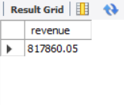
VISUALS OF DATA ANALYSED

Slide 7
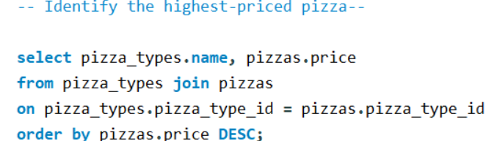
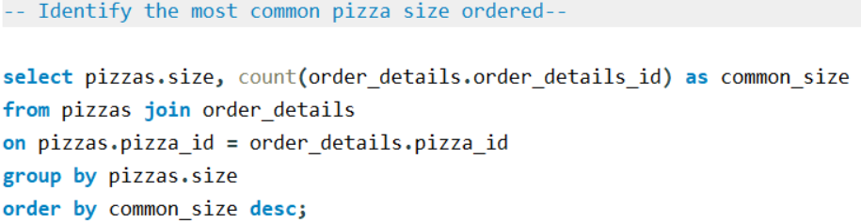
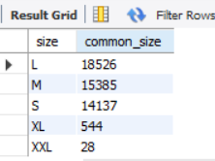
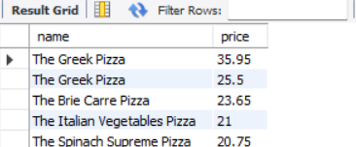
VISUALS OF DATA ANALYSED

Slide 8
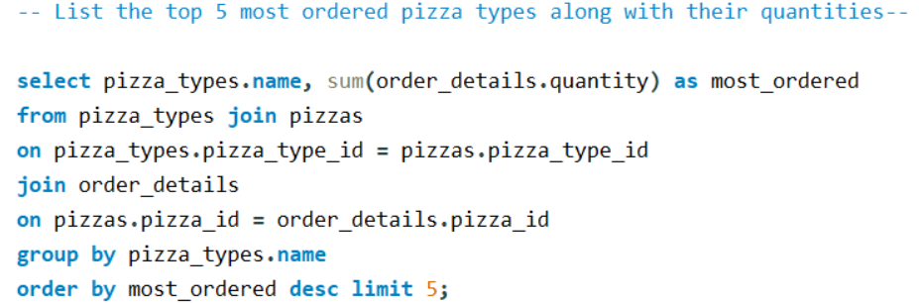
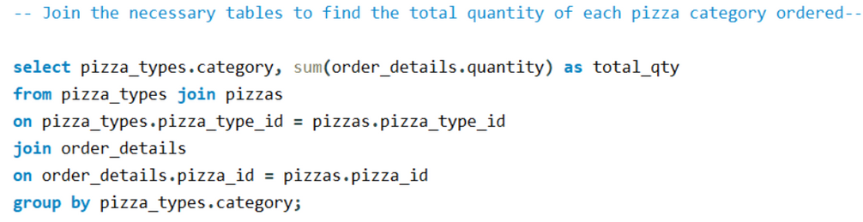
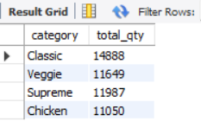
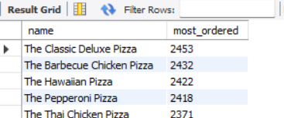
VISUALS OF DATA ANALYSED

Slide 9
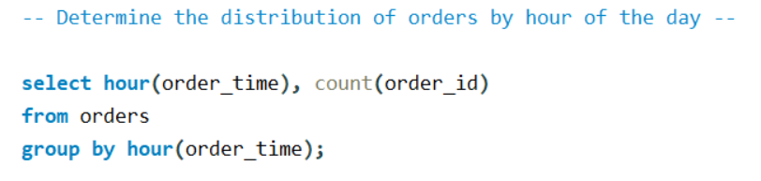
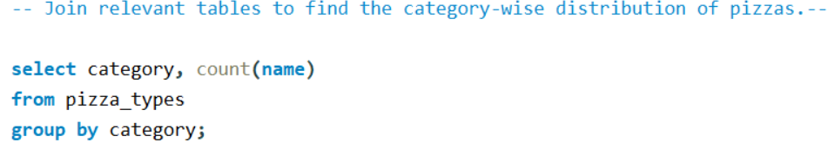
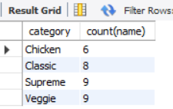
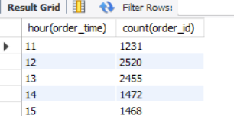
VISUALS OF DATA ANALYSED

Slide 10
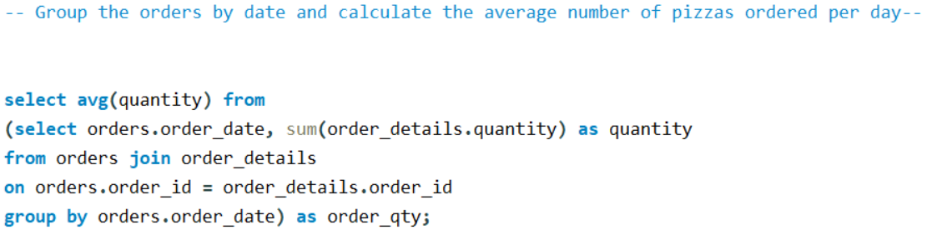
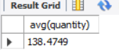
VISUALS OF DATA ANALYSED

Slide 11
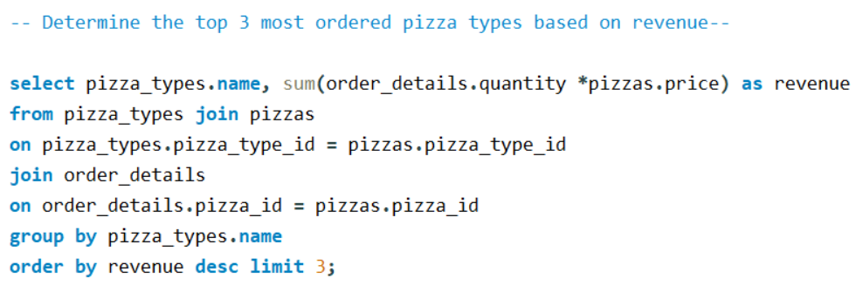
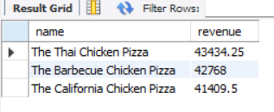
VISUALS OF DATA ANALYSED

Slide 12
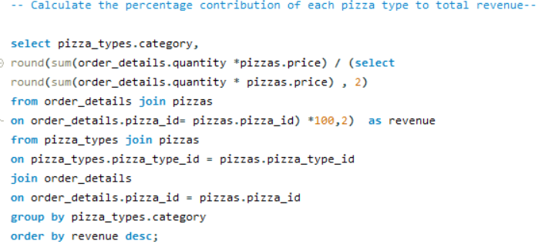
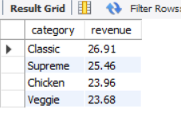
VISUALS OF DATA ANALYSED

Slide 13
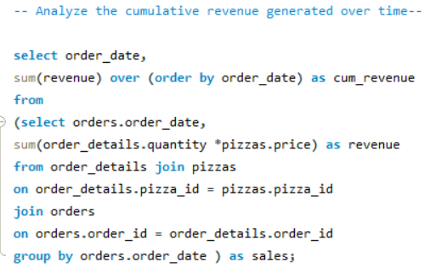
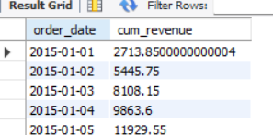
VISUALS OF DATA ANALYSED

Slide 14
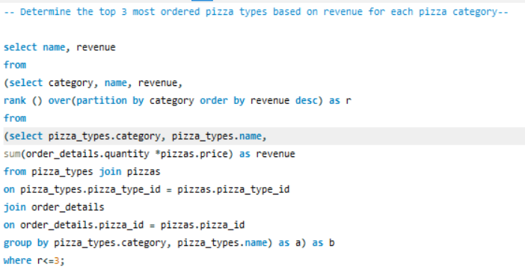
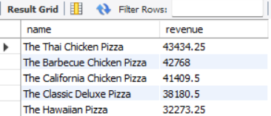
VISUALS OF DATA ANALYSED

Slide 15
THANK YOU
FOR ATTENTION

